Slide 1
Index Law 3 and 4
Miss L
Year 8

Slide 2
Last Lesson Recap
1. 2² x 2³ = 2. a³ x a² =
3. 2⁴ x 2⁶ = 4. 17⁶ ÷ 17⁴ =
5. y⁶ ÷ y³ = 6. r⁹ x r³ ÷ r⁶ =

Slide 3
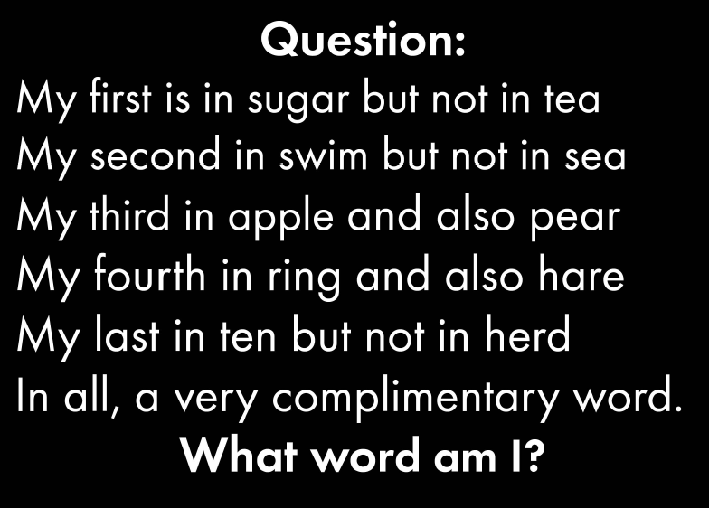

Slide 4
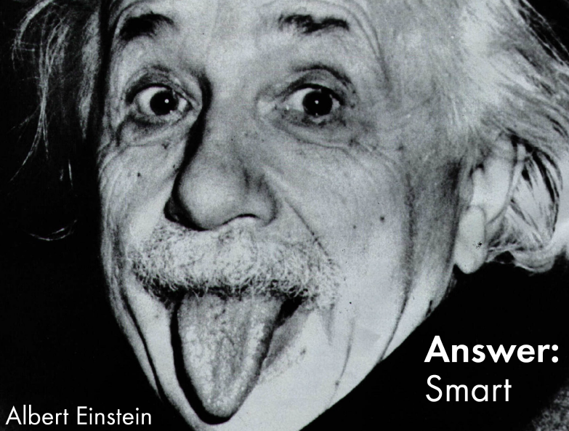

Slide 5
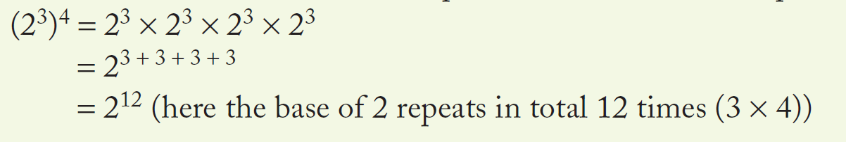

24
7
30
Index Law 3 and 4
Date
EQ – Describe how the index laws can be used to simplify expressions with indices.
$$(a^{m})^{n}=a^{m×n}$$
Index Law 3
Use when a number written in index notation is raised to another power.
The base remains the same and the two powers (indices) are multiplied together.

Slide 6
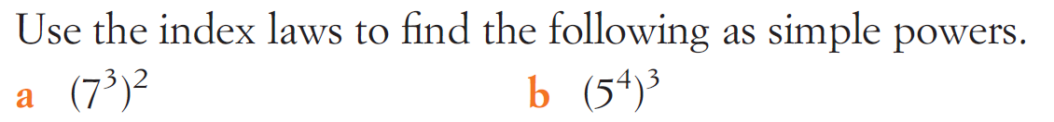
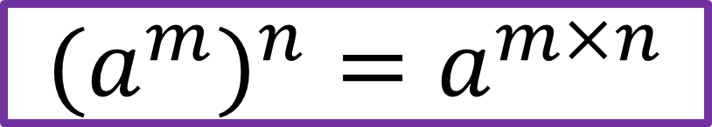
Examples
$$(a^{m})^{n}=a^{m×n}$$

Slide 7
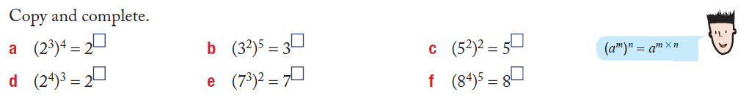
Practice

Slide 8


Slide 9
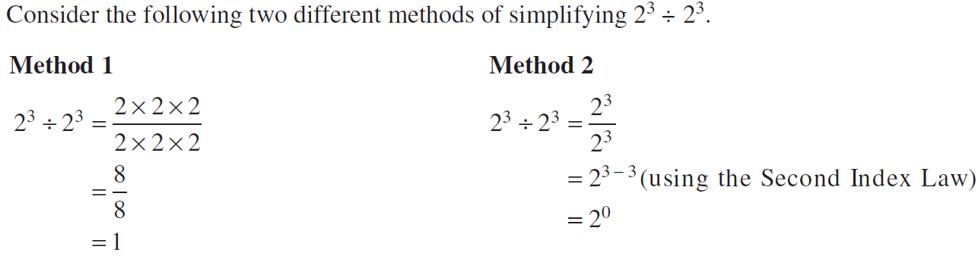
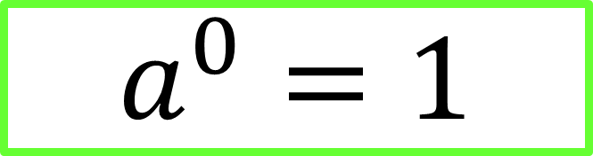
24
7
30
Index Law 3 and 4
Date
EQ – Describe how the index laws can be used to simplify expressions with indices.
Index Law 4
$$a^{0}=1$$

Slide 10
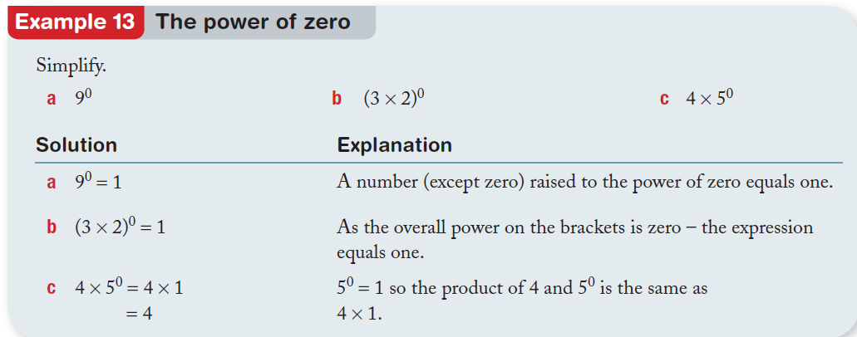
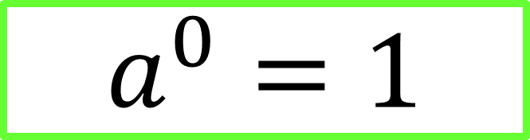
Examples
$$a^{0}=1$$

Slide 11
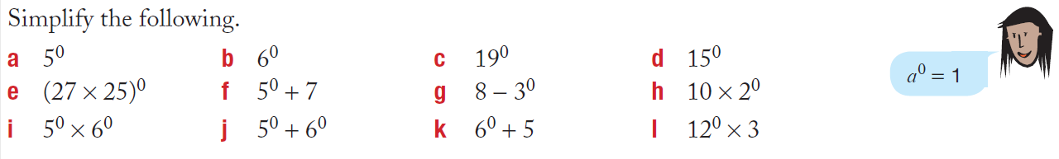
Practice

Slide 13
Task
Complete worksheet
Complete Summery

